Slide 1


Hii,
Iam Siddhika
Welcome to Power BI Series
Part -46

Slide 2



We focus only on the most used and important Dax Functions
Today Content
Meet DAX
I’m soo Excited. It’s my favourite functions.
Are you ready guys?
COMMON FUNCTION CATEGORIES
7.TIME INTELLIGENCE FUNCTIONS
DATEADD DATESBETWEEN DATESINPERIOD
DATESINPERIOD Vs DATESBETWEEN

Slide 3

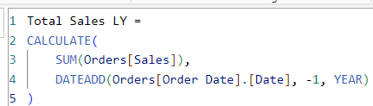
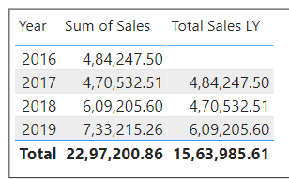

DATEADD
The DATEADD function in DAX is used for time intelligence calculations. It shifts the given dates by a specified interval and returns a table of dates. This function is useful for comparing data across different time periods.
Check this
Syntax
DATEADD(<dates>,<number_of_intervals>,<interval>)
dates: A column containing dates.
number_of_intervals: The number of intervals to shift the dates. Positive numbers move forward, negative numbers move backward.
interval: The interval by which to shift the dates. This can be "DAY", "MONTH", "QUARTER", or "YEAR".
_{Example} To calculate the total sales amount from the same period last year, you can create a measure that uses DATEADD.
This visual shows Total sales LY gives the sales amount for the last year of each year.
SUM(Orders[Sales]): Sums the Sales column. DATEADD(Sales[OrderDate], -1, YEAR): Shifts the OrderDate column by -1 year to get the same period last year.

Slide 4

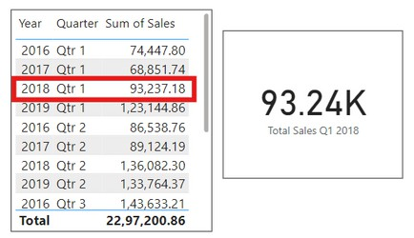

DATESBETWEEN
DATESBETWEEN function is used to filter a table or a column of dates based on a specified range. This function is commonly used in time intelligence calculations to retrieve data for a specific time period
Easy?
Syntax
DATESBETWEEN(<Dates>, <StartDate>, <EndDate>)
<dates>: A column containing dates.
<start_date>: The start date of the range.
<end_date>: The end date of the range.
Here just i’m taking for example to understand.
Example
To calculate the total sales amount for a specific time period, you can use the DATESBETWEEN function.
SUM(Orders[SalesAmount]): Aggregates the Sales column.
DATESBETWEEN(Orders[OrderDate], DATE(2018, 1, 1), DATE(2018,
3, 31)): Filters the OrderDate column to include dates between January 1, 2018, and March 31, 2018.
The result of this calculation will be the total sales amount for the first quarter (Q1) of 2018.
The DATESBETWEEN function can also be used with other time intelligence functions like TOTALYTD, TOTALQTD, and TOTALMTD to calculate year-to-date, quarter-to-date, and month-to-date totals, respectively.

Slide 5

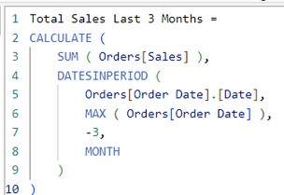
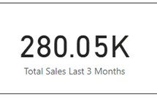
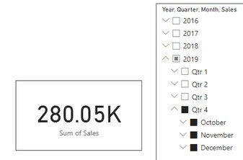
DATESINPERIOD
The DATESINPERIOD function in DAX returns a table with a single column of dates. This table starts at a specified date and continues for a specified number of intervals (days, months, quarters, or years).
I think
Syntax
DATESINPERIOD(<dates>, <start_date>, <number_of_intervals>, <interval>)
easy for
you
dates: A column that contains dates.
start_date: The start date as a scalar value.
number_of_intervals: The number of intervals to add or subtract from the start date.
interval: The interval to use (DAY, MONTH, QUARTER, YEAR).
Example
Here just i’m taking for example to understand.
How can you create a measure to calculate the total sales amount for the last 3 months from the most recent order date using the Orders table and the OrderDate column?
SUM(Orders[SalesAmount]): Sums the Salescolumn. DATESINPERIOD(Orders[OrderDate], MAX(Orders[OrderDate]), -3, MONTH): Gets a set of dates from orders[OrderDate] starting from the latest date in the column and going back 3 months.

Slide 6
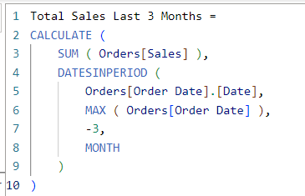
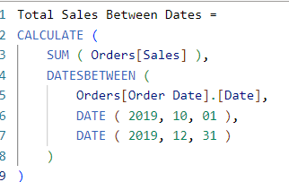
Comparison of DATESINPERIOD with DATESBETWEEN
DATESBETWEEN is used to get dates between two specific dates. DATESINPERIOD is used to get dates for a specific interval relative to a start date.
Understood?
Example Comparison
Using DATESINPERIOD
Using DATESBETWEEN
This both dax calculates the total sales amount for the last 3 months from the most recent order date

Slide 7


Thank you for joining me today to learn about Part -46 of Power BI!
Remember, Learning DAX is key to unlocking the full potential of Power BI for insightful reporting and visualization.
Stay tuned for more insights and tips on Power BI in our next Series.
Follow

